Slide 1
Using Strong Structuration Theory to Explore Accountants’ Intra-organisational Communication Networks
Lyn Daff
University of Southern Queensland

Slide 2
Overview
Why accountants’ networks are important
A little prior literature
Research questions
Why use strong structuration theory?
Research approach
Findings and discussion
Conclusion

Slide 3
Why accountants’ networks are important
Networks = those with whom accountants communicate
Networks facilitate the dissemination of accounting information
Establishing and sustaining relationships takes considerable effort (Jones, 1999)
Important for CFOs to develop relationships with other leaders (IFA, 2013)

Slide 4
A little prior literature
50% CFOs - interdepartmental relations a barrier to CFO role effectiveness
27% and CFOs - relationships with non-financial managers a barrier to role effectiveness (Ernst & Young, 2013)
Internal networks vital for a CFO career (Kambil et al., 2009)
Successful FCs diligent in relationship building (Ernst and Young, 2008)
MAs need to build relationships across business areas and different levels of seniority (Burns and Baldvinsdottir, 2007)
CFOs anticipate networks will expand (IBM, 2013)

Slide 5
A little prior literature
Chapman (1998) networks, performance and uncertainty
CFO roles and relationships that arise from roles (Ernst & Young, 2013)

Slide 6
Why use strong structuration theory?
Elements of interest
General-dispositions
Conjunturally-specific knowledge
Active agency
Outcomes of agency
Position-practices

Slide 7
A
An agent-in-focus
AGENT
External structures
Internal structures
Active agency/
Agent’s practices
Outcomes
conjuncturally-
specific knowledge of external structures
general-disposition or habitus
A
Source:
Stones, 2005, p. 85
B
Position-practice relations

Slide 8
The research approach
30 accountants, from SA, NSW and Victoria
15 CFOs, 9 FCs, 6 other
20 males, 10 females
Organisations: education, social services, health and religious
Snowball approach
Semi-structured interviews
Thematic analysis

Slide 9
Research objectives
Accountants’ perceptions regarding their networks:
Importance attached to networks
Parties that make up networks
Procedures for establishing networks
Factors that influence composition and development of networks

Slide 10
The importance of networks
Dispositional
“If we’re going to succeed, then there’s a need to build the right relationships, if you’re going to be able to communicate effectively.”
“My role also, I think, is very relational: building relationships with all the different stakeholders”.
Positional

Slide 11
Strategies for building networks
Football tipping
Proactivity
Face-to-face contact
Communication style – pitch conversation so it is understandable, don’t be abrupt
Conjucturally-specific knowledge of others

Slide 12
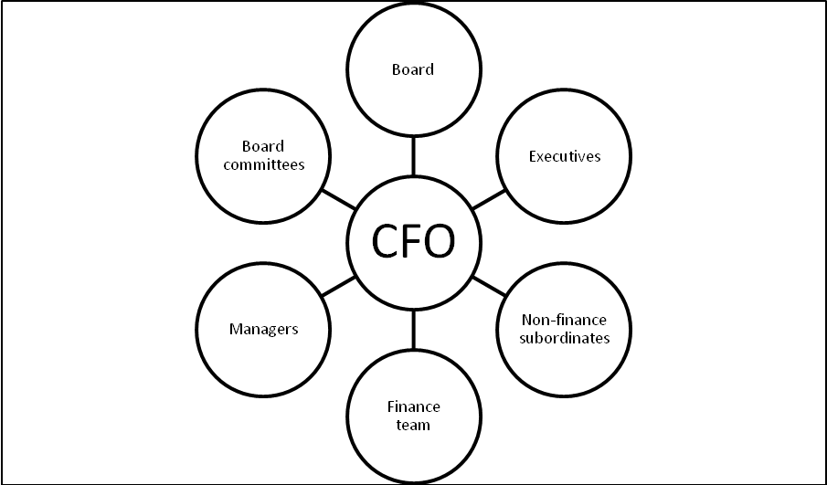
CFOs’ primary network partners

Slide 13
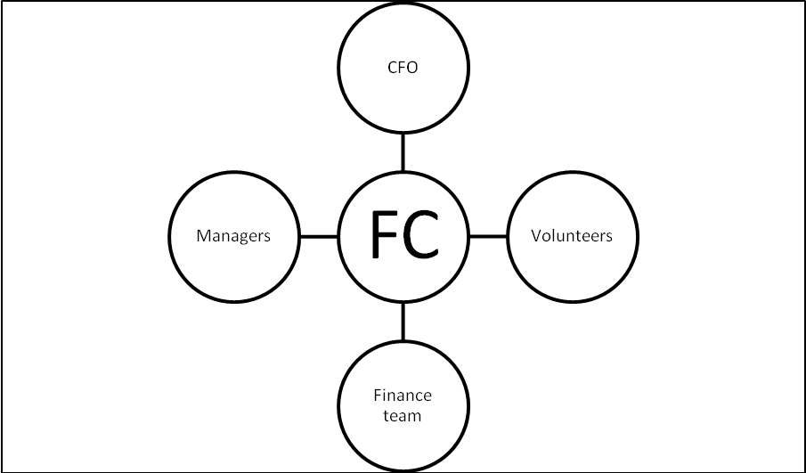
FCs’ primary network partners

Slide 14
Influences on accountants’ networks
The positional
General-dispositions
The conjucturally-specific

Slide 15
The positional
Expectations concerning a role or position
CFOs – strategic role
Supporting role
Managing role
Reporting role
with whom they interact

Slide 16
General dispositions
Philosophies, values and beliefs
Openness and honesty
Approachable
Get out of their office
processes for building networks

Slide 17
Conjucturally specific
Knowledge of how others might interpret one’s words and actions
Trying to understand others and tailor information to their needs
Awareness of own and others’ power
CFOs’ position gives view of leaders

Slide 18
Conjucturally specific
Knowledge of others’ beliefs and how they might act in different situations
Happy to answer questions leads to questions
Having a sense of how people work – tailor communication approach

Slide 19
Conclusion
Networks are important, building relationships part of an accountant’s role
Face-to-face facilitates relationships
Position-practices those who make up accountants’ networks
Accountant’s position influences network

Slide 20
Limitations & future research
NFP organisations cf for-profits
Snowball sampling cf survey
Viewpoint of accountants cf others
Interviews cf observations

Slide 21
Closing thoughts
As accountants built relationships:
Influenced others
Provided meaning
Impacted organisational norms

